Slide 1
Introduction to Probability

Slide 2
Experiment, Outcomes, and Sample Space
Experiment
- Is a process that, when performed, results in one and only one of many observations.
Outcomes
- These observations are called the outcomes of the experiment
Sample Space
- The collection of all outcomes for an experiment is called a sample space denoted by S

Slide 3
Experiment, Outcomes, and Sample Space
Example
Experiment | Outcomes | Sample Space
Toss a coin once | H, T | S={H,T}
Roll a dice once
Toss a coin twice
Play Lottery
Take a test
Notes:
S={1, 2, 3, 4, 5, 6}
S= {HH, HT, TH, TT}
S= {Win, Lose}
S= {Pass, Fail}

Slide 4
Tree diagram
In a tree diagram, each outcome is represented by a branch of the tree.
Example
Draw the tree diagram for the experiment of tossing a coin twice.

Slide 5

Calculating Probability
Probability is a numerical measure if the likelihood that a specific event will occur, is denoted by P.
the probability that a compound event A will occur is denoted by $P(A)$.

Slide 6

Two Properties of Probability
$$0≤P(x)≤1 \\ \sum{P(x)}=1$$

Slide 7
Three Conceptual Approached to Probability
Classical probability
Relative frequency concept of probability
Subjective probability concept.

Slide 8
Classical Probability
Classical Probability
The classical probability rule is applied to compute the probabilities of events for an experiment for which all outcomes are equally likely.
Example
Find the probability of obtaining a head and the probability obtaining a tail for tossing a coin once.
Example
Find the probability of obtaining an even numbers for rolling a dice once.
Notes:
P(H) = ½ = 0.5
P(Even) = 3/6 = 0.5

Slide 9
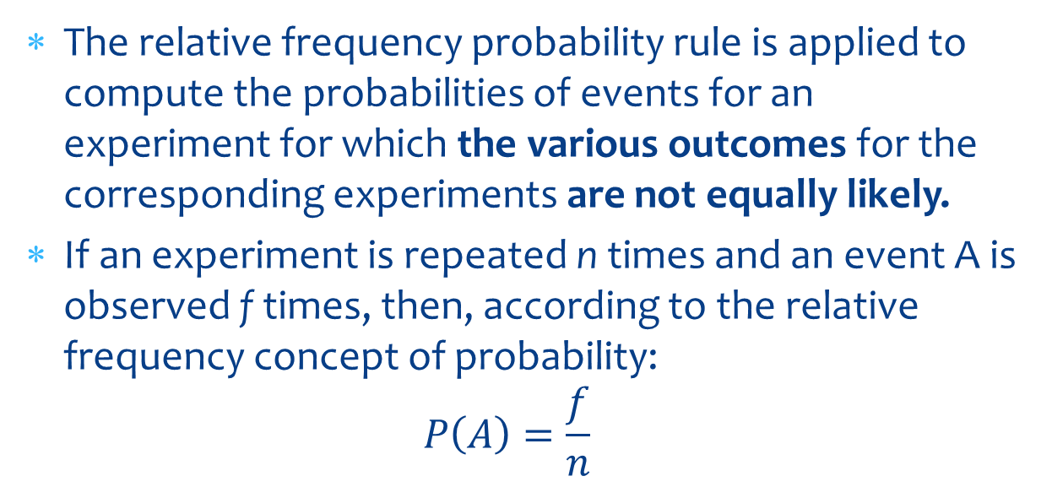
Relative Frequency Concept of Probability
The relative frequency probability rule is applied to compute the probabilities of events for an experiment for which the various outcomes for the corresponding experiments are not equally likely.
If an experiment is repeated n times and an event A is observed f times, then, according to the relative frequency concept of probability: $P\left(A\right)=\frac{f}{n}$

Slide 10
Relative Frequency Concept of Probability
Example
Ten of the 500 randomly selected cars manufactured at a certain auto factory are found to be malfunctioning. Assuming that the cars are manufactured randomly, what is the probability that the next car manufactured at this auto factory is malfunctioning?
Notes:
10/500 = 0.02

Slide 11
Subjective Probability
Subjective probability is the probability assigned to an event influenced by the biases on subjective judgment, experience, information and belief.
Notes:
. Example: The Probability that Lim, who is taking DS course, will earn an A in the course.
So it is based on previous experience and beliefs but not on a mathematical model

Slide 12
Marginal and Conditional Probabilities
Marginal Probability
Marginal probability is the probability of a single event without consideration of any other event. They are calculated by dividing the corresponding row margins (total of the rows) or column margins (total of the columns) by the grand total.

Slide 13

Marginal Probability
 | In Favor | Against
Male | 15 | 45 | 60
Female | 4 | 356 | 360
 | 19 | 401 | 420
Example
$P\left(Male\right)=\frac{No of males}{Total no of employees}=\frac{60}{420}$
$P\left(Female\right)=\frac{360}{420}$
$P\left(In Favor\right)=\frac{19}{420}$
$P\left(Against\right)=\frac{401}{420}$

Slide 14
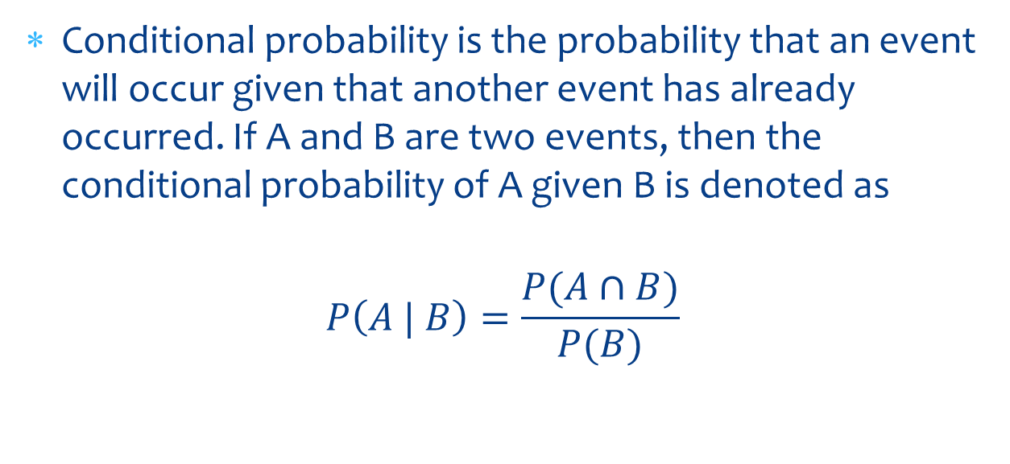
Conditional Probability
Conditional probability is the probability that an event will occur given that another event has already occurred. If A and B are two events, then the conditional probability of A given B is denoted as
$$P\left(A | B\right)=\frac{P(A∩B)}{P(B)}$$

Slide 15
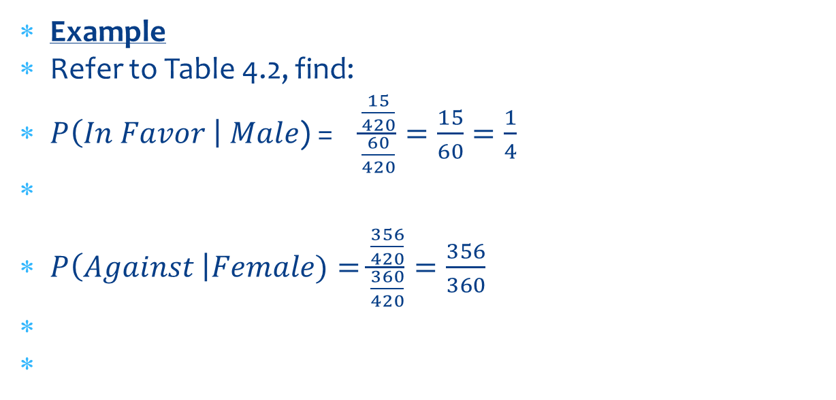
Conditional Probability
 | In Favor | Against
Male | 15 | 45 | 60
Female | 4 | 356 | 360
 | 19 | 401 | 420
Example
Refer to Table 4.2, find:
$P\left(In Favor \right| Male$) = $\frac{\frac{15}{420}}{\frac{60}{420}}=\frac{15}{60}=\frac{1}{4}$
$P\left(Against \right|Female)=\frac{\frac{356}{420}}{\frac{360}{420}}=\frac{356}{360}$

Slide 16

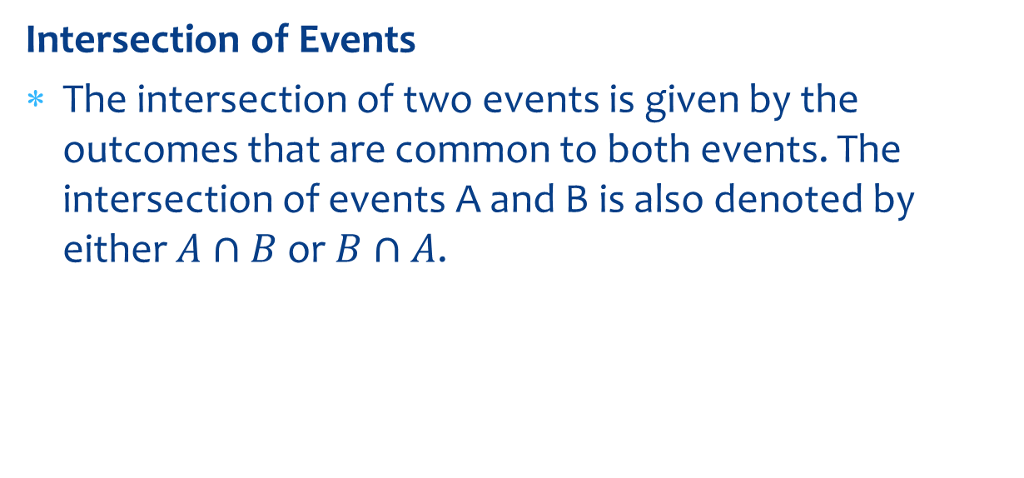
Intersection of Events
Intersection of Events
The intersection of two events is given by the outcomes that are common to both events. The intersection of events A and B is also denoted by either $A∩B$ or $B∩A$.

Slide 17
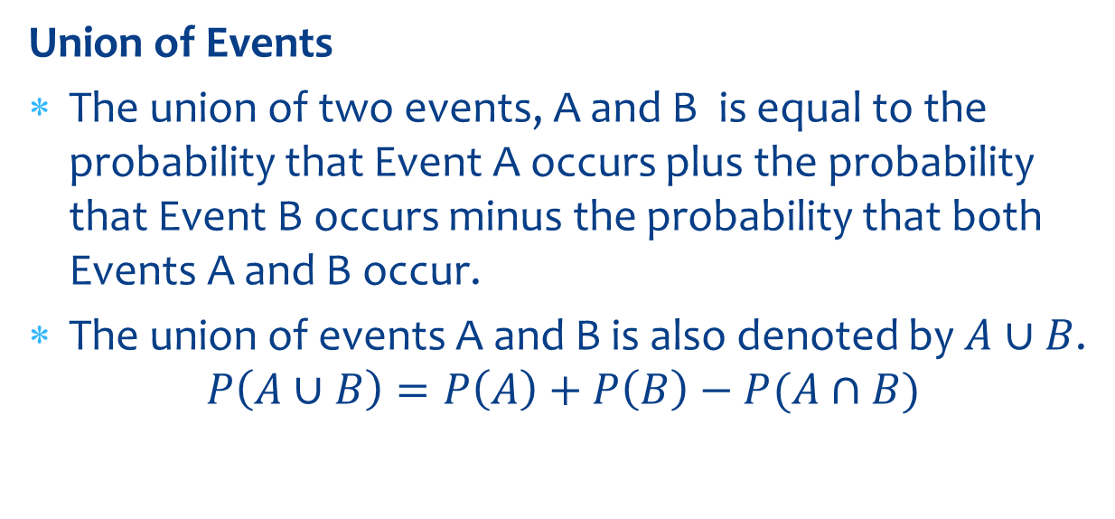
Union of Events
Union of Events
The union of two events, A and B is equal to the probability that Event A occurs plus the probability that Event B occurs minus the probability that both Events A and B occur.
The union of events A and B is also denoted by $A∪B$.
$$P\left(A∪B\right)=P\left(A\right)+P\left(B\right)−P(A∩B)$$

Slide 18
Union of Events
Example
A university president has proposed that all students must take a course in ethics as a requirement for graduation. Three hundred faculty members and students from this university were asked about their opinion on this issue. The table below gives a two-way classification of the responses of these faculty members and students.

Slide 19
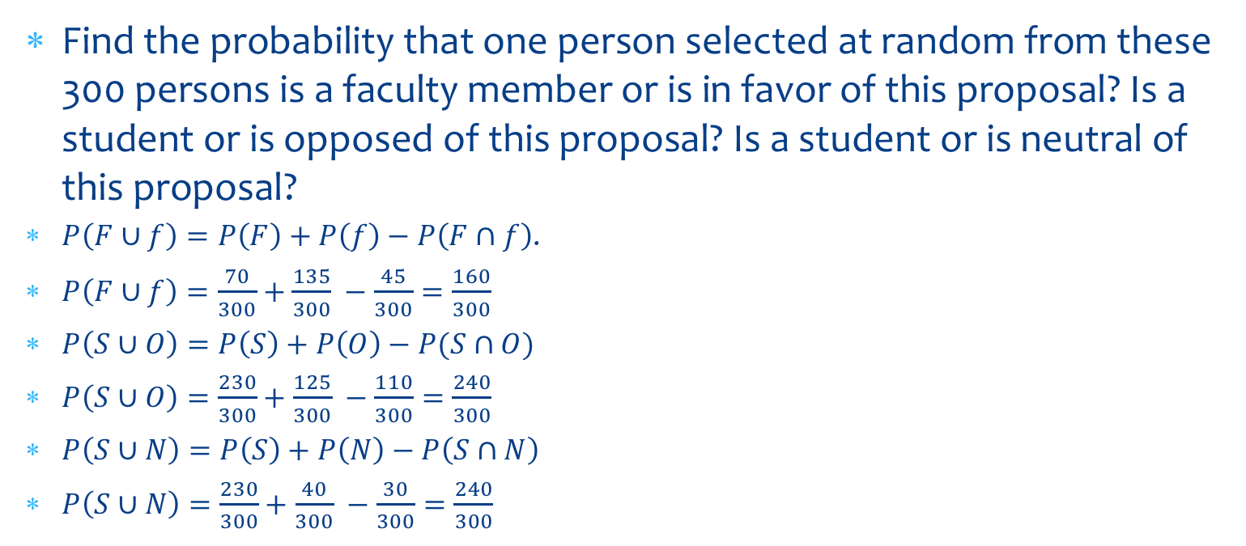
Union of Events
Find the probability that one person selected at random from these 300 persons is a faculty member or is in favor of this proposal? Is a student or is opposed of this proposal? Is a student or is neutral of this proposal?
$P\left(F∪f\right)=P\left(F\right)+P\left(f\right)−P\left(F∩f\right)$.
$P\left(F∪f\right)=\frac{70}{300}+\frac{135}{300} −\frac{45}{300}=\frac{160}{300}$
$P\left(S∪O\right)=P\left(S\right)+P\left(O\right)−P(S∩O)$
$P\left(S∪O\right)=\frac{230}{300}+\frac{125}{300} −\frac{110}{300}=\frac{240}{300}$
$P\left(S∪N\right)=P\left(S\right)+P\left(N\right)−P\left(S∩N\right)$
$P\left(S∪N\right)=\frac{230}{300}+\frac{40}{300} −\frac{30}{300}=\frac{240}{300}$
 | Favor (f) | Oppose (O) | Neutral (N) | Total
Faculty (F) | 45 | 15 | 10 | 70
Student (S) | 90 | 110 | 30 | 230
Total | 135 | 125 | 40 | 300

Slide 20
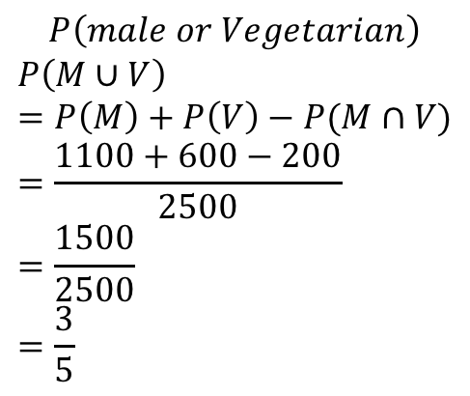
Intersection and Union
Example
In a group of 2500 persons, 1400 are female, 600 are vegetarian and 400 are female and vegetarian. What is the probability that a randomly selected person from this group is a male or vegetarian?
$$P\left(male or Vegetarian\right)$$
$$P\left(M∪V\right)=P\left(M\right)+P\left(V\right)−P(M∩V) \\ =\frac{1100+600−200}{2500} \\ =\frac{1500}{2500} \\ =\frac{3}{5}$$
 | Male | Female
Vegetarian | 200 | 400 | 600
Non-Vegetarian | 900 | 1000 | 1900
 | 1100 | 1400 | 2500

Slide 21
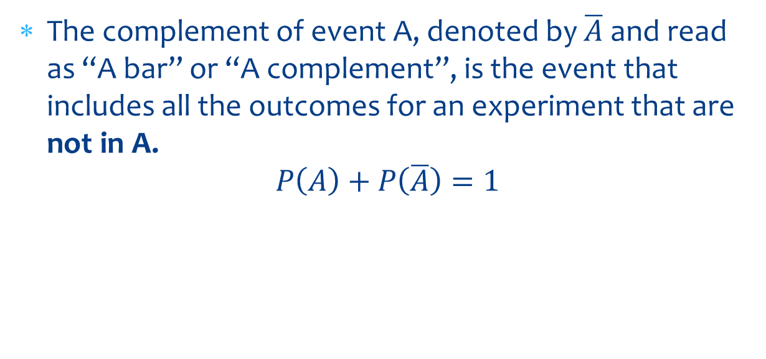
Complementary Events
The complement of event A, denoted by $\overline{A}$ and read as “A bar” or “A complement”, is the event that includes all the outcomes for an experiment that are not in A.
$$P\left(A\right)+P\left(\overline{A}\right)=1$$

Slide 22
Complementary Events
Example
In a group of 2000 taxpayers, 400 have been audited by IRS at least once. If one taxpayer is randomly selected from this group, what are the two complementary events of this experiment, and what are their probabilities?

Slide 23
Example Solution
The two complementary events for this experiment are
A = the selected taxpayer has been audited by the IRS at least once
Ā = the selected taxpayer has never been audited by the IRS
The probabilities of the complementary events are
P (A) = 400/2000 = .20 and
P (Ā) = 1600/2000 = .80

Slide 24
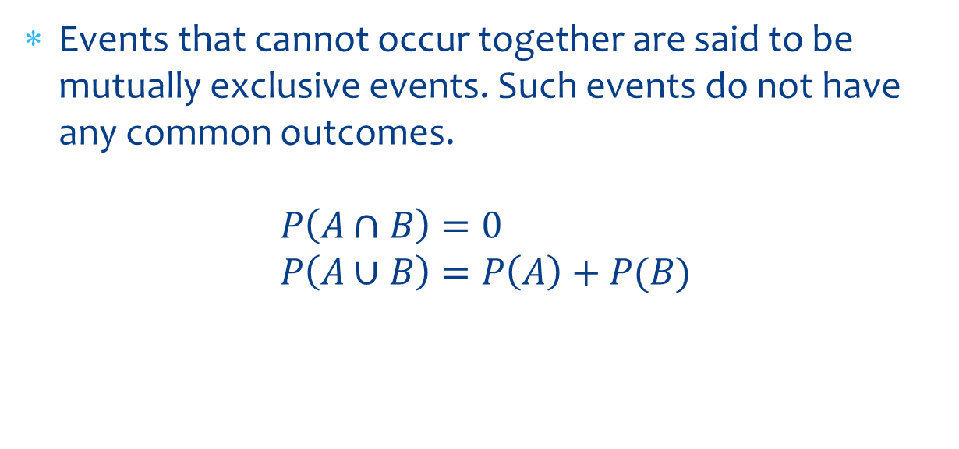
Mutually Exclusive Events
Events that cannot occur together are said to be mutually exclusive events. Such events do not have any common outcomes.
$$P\left(A∩B\right)=0 \\ P\left(A∪B\right)=P\left(A\right)+P(B)$$

Slide 25
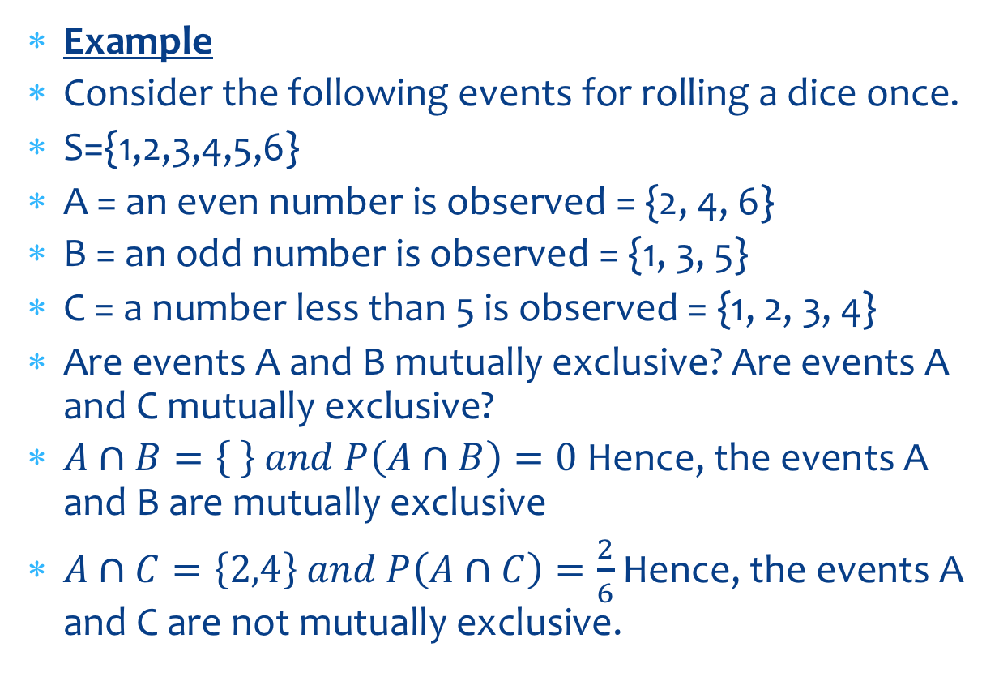
Mutually Exclusive Events
Example
Consider the following events for rolling a dice once.
S={1,2,3,4,5,6}
A = an even number is observed = {2, 4, 6}
B = an odd number is observed = {1, 3, 5}
C = a number less than 5 is observed = {1, 2, 3, 4}
Are events A and B mutually exclusive? Are events A and C mutually exclusive?
$A∩B=\left\{ \right\} and P\left(A∩B\right)=0$ Hence, the events A and B are mutually exclusive
$A∩C=\left\{2,4\right\} and P\left(A∩C\right)=\frac{2}{6}$ Hence, the events A and C are not mutually exclusive.

Slide 26
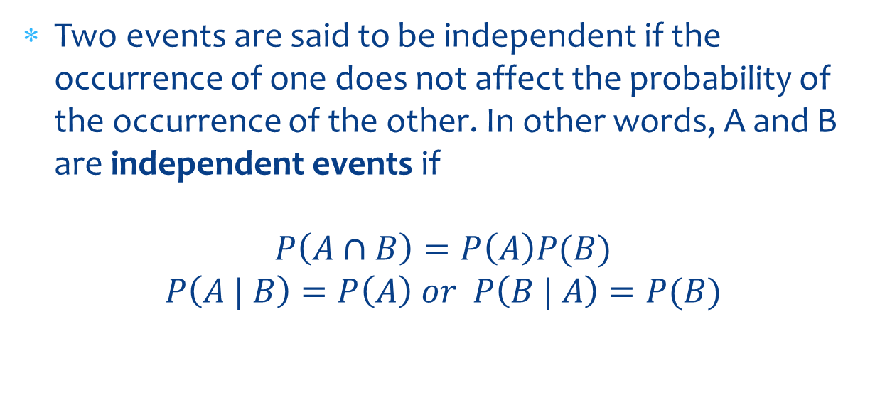
Independent and Dependent Events
Two events are said to be independent if the occurrence of one does not affect the probability of the occurrence of the other. In other words, A and B are independent events if
$$P\left(A∩B\right)=P\left(A\right)P(B)$$
$$P\left(A | B\right)=P\left(A\right) or P\left(B | A\right)=P(B)$$

Slide 27

Independent and Dependent Events
A and B are dependent events if
$P\left(A∩B\right)=P\left(A\right)P\left(B \right| A$)
$$P\left(A∩B\right)=P\left(B\right)P\left(A \right|B )$$

Slide 28
Independent and Dependent Events
Example
A box contains a total of 100 CDs that were manufactured on two machines. Of them, 60 were manufactured on Machine I. Of the total CDs, 15 are defective. Of the 60 CDs that were manufactured on Machine I, 9 are defective. Let D be the event that a randomly selected CD is defective, and let A be the event that a randomly selected CD was manufactured on Machine I. Are events A and D independent?
Notes:
Check whether P(A$∩D)=P(A)P(D).$

Slide 29
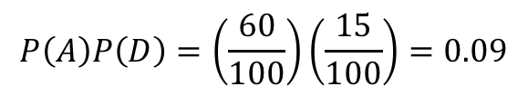
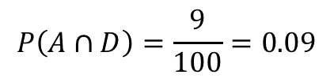

Independent and Dependent Events
 | Defective (D) | Not Defective | Total
Machine 1 (A) | 9 | 51 | 60
Not Machine 1 | 6 | 34 | 40
Total | 15 | 85 | 100
$$P\left(A∩D\right)=\frac{9}{100}=0.09$$
$$P\left(A\right)P\left(D\right)=\left(\frac{60}{100}\right)\left(\frac{15}{100}\right)=0.09$$
P(A$∩D)=P(A)P(D)$
The events A and D are independent events because P(A$∩D)=P(A)P(D).$

